Slide 1


Hotel Cancellation Prediction
Data-245-Machine Learning Technologies
Final Presentation
Under the guidance of Prof Shih Yu. Chang

Slide 2



Introduction

Slide 3
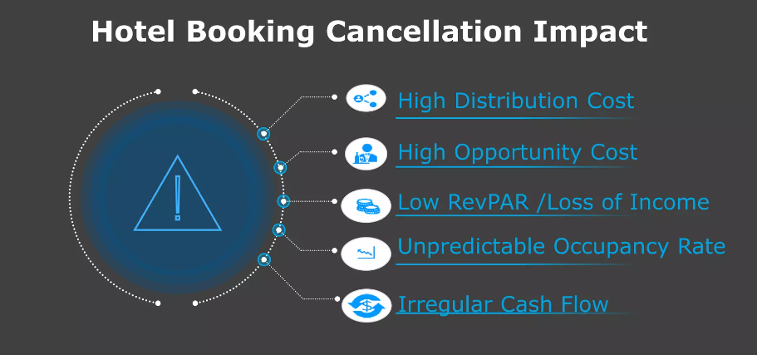
Problem Statement and Objective
Problem Statement
Cancellation of Reservations
Project Objective
Predicting if hotel reservation made in future will be cancelled or not.
Hotels can minimize lost profit.

Slide 4
Technology Survey & Literature survey
Authors | Objective | Datasets | Models Used | Results
VincentCho | Comparison of three different approaches to tourist arrival forecasting | Hong Kong Tourist Association (1974–2000) | compares exponential smoothing, seasonal ARIMA and ANN in forecasting | Neural Network gave the higher accuracy
Agustín J. Sánchez-Medina, Eleazar C-Sánchez | Using machine learning and big data for efficient forecasting of hotel booking cancellations | four-star hotel partner located in Gran Canaria (Spain) were used | Random forest, Support vector machine, ANN (GA optimized), ANN (GA optimized) | ANN (GA optimized) outperformed and gave higher accuracy
Adil, M.; Ansari, M.F.; Alahmadi, A.; Wu, J.-Z.; Chakrabortty, R.K | Solving the Problem of Class Imbalance in the Prediction of Hotel Cancellations | Portuguese hotel chain data | Random forest with SMOTE-ENN | Solved the Imbalanced problem

Slide 5
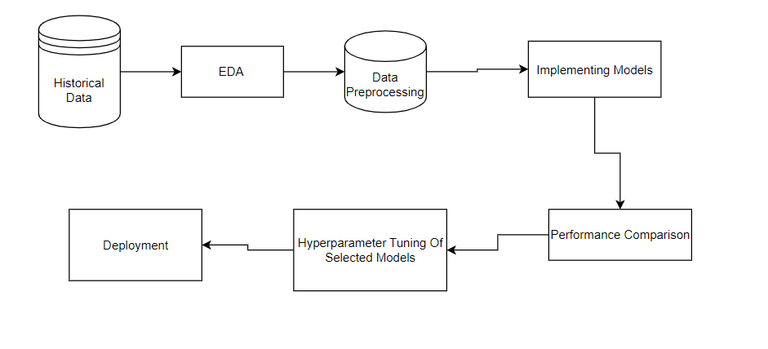
Architecture

Slide 6
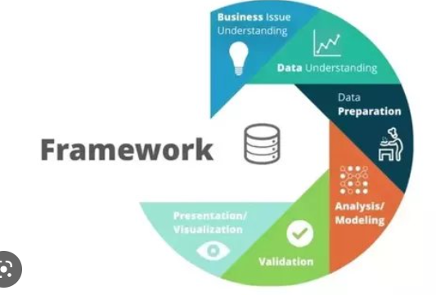
Project Data Flow
Business Understanding
Data Understanding
Data Preparation
Analysis/ Modelling
Validation
Visualization

Slide 7
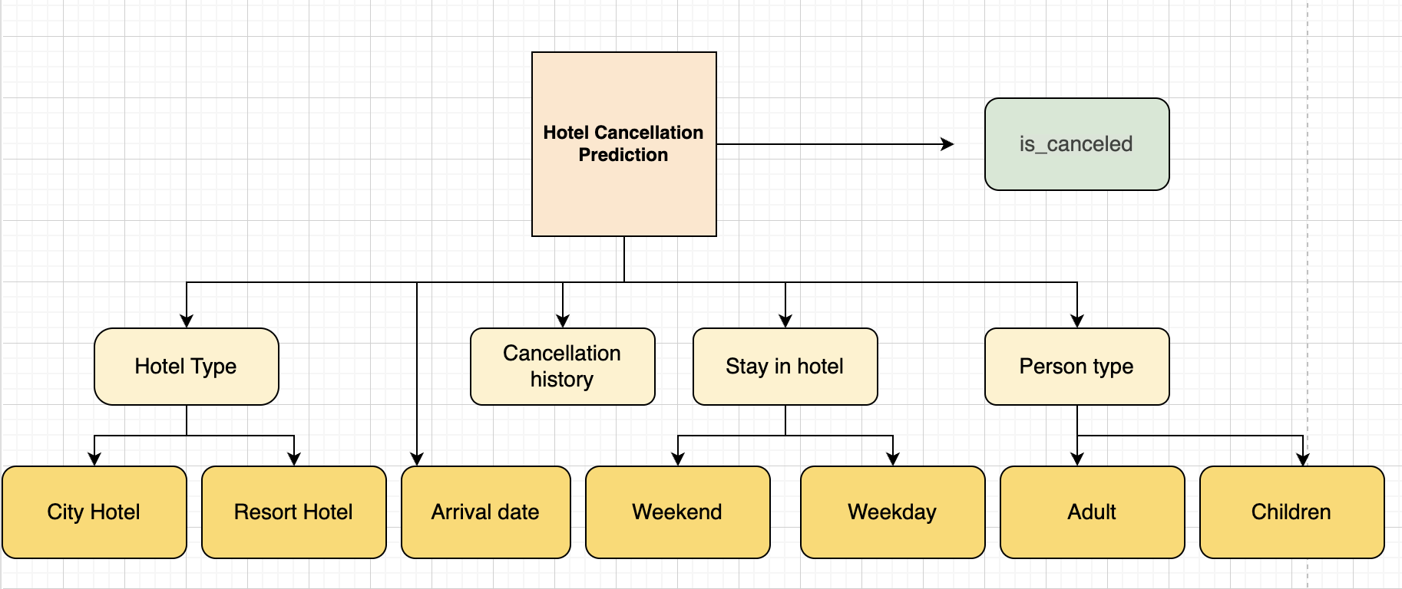
ABT For Hotels Data

Slide 8
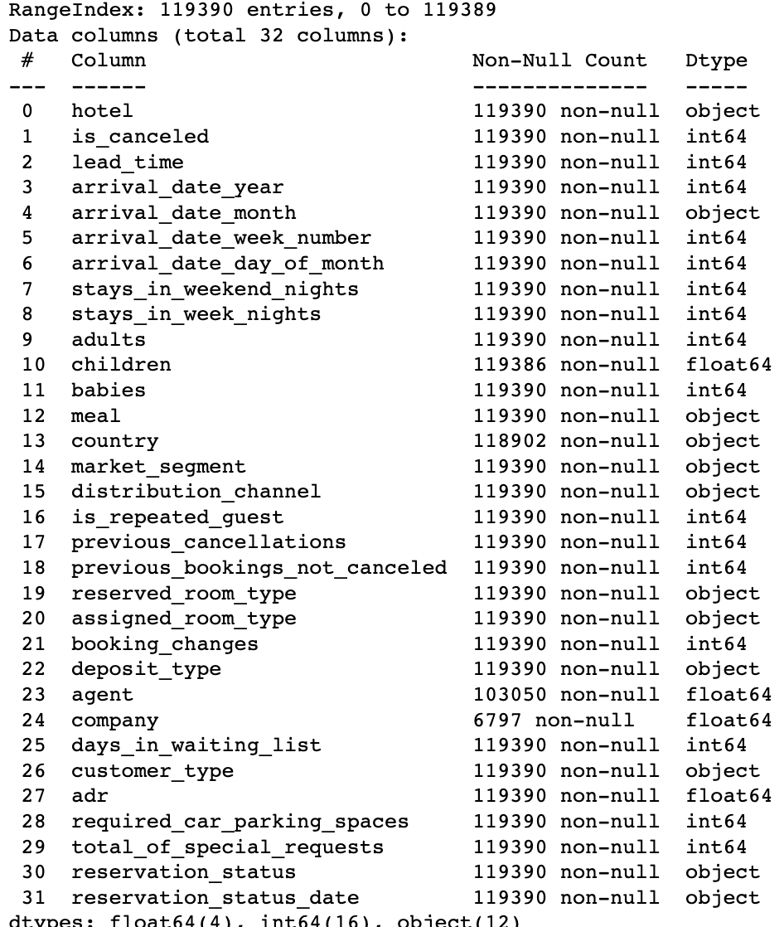
Data Description
Continuous Variables ( 13 )
Categorical Variables( 17 )
119390 data points in dataset

Slide 9
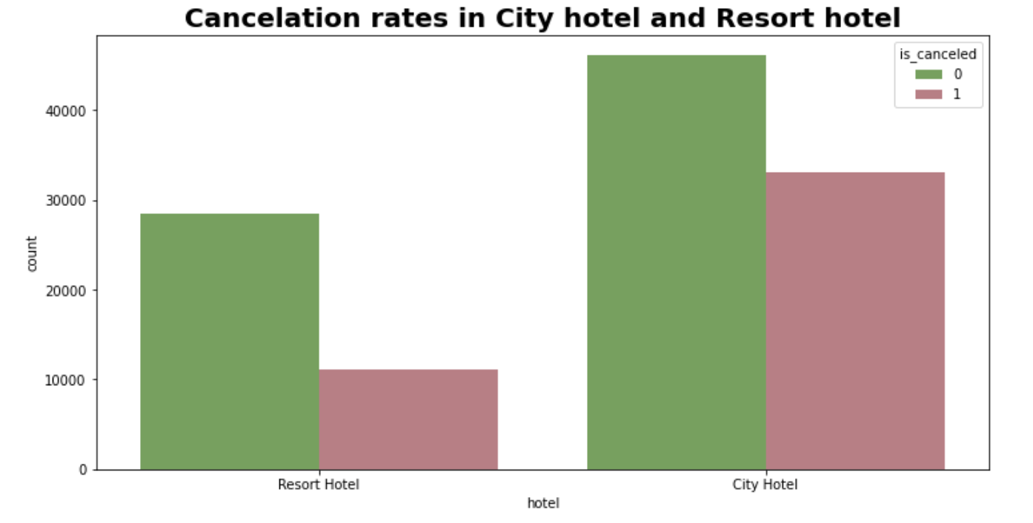
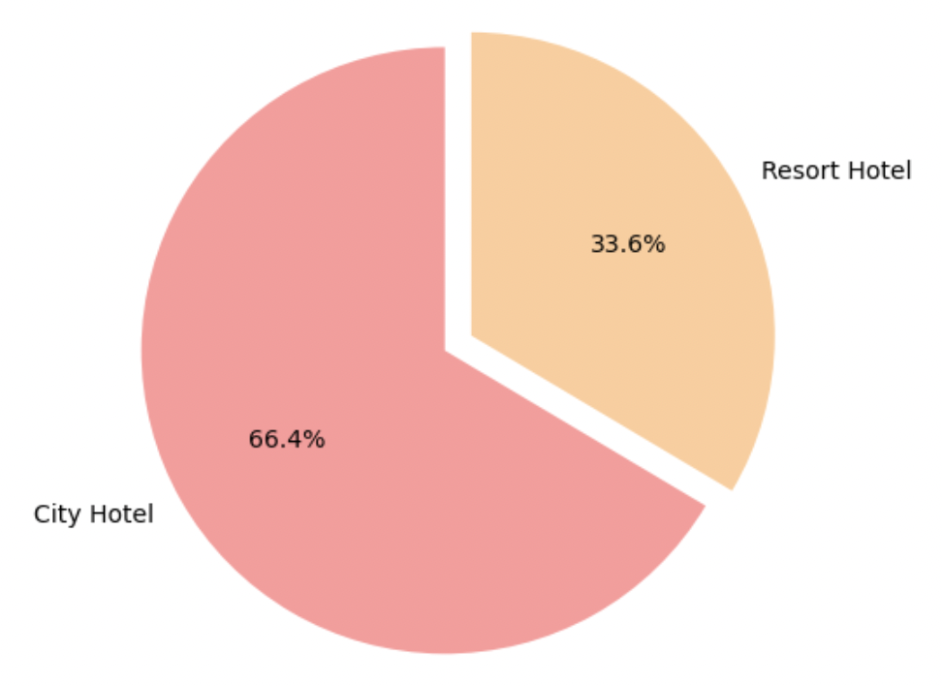
Exploration Data Analysis

Slide 10
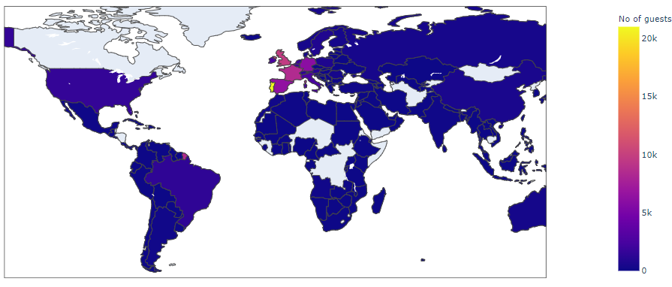
EDA cont.
Most of the guest are from Portugal and other countries in Europe.

Slide 11
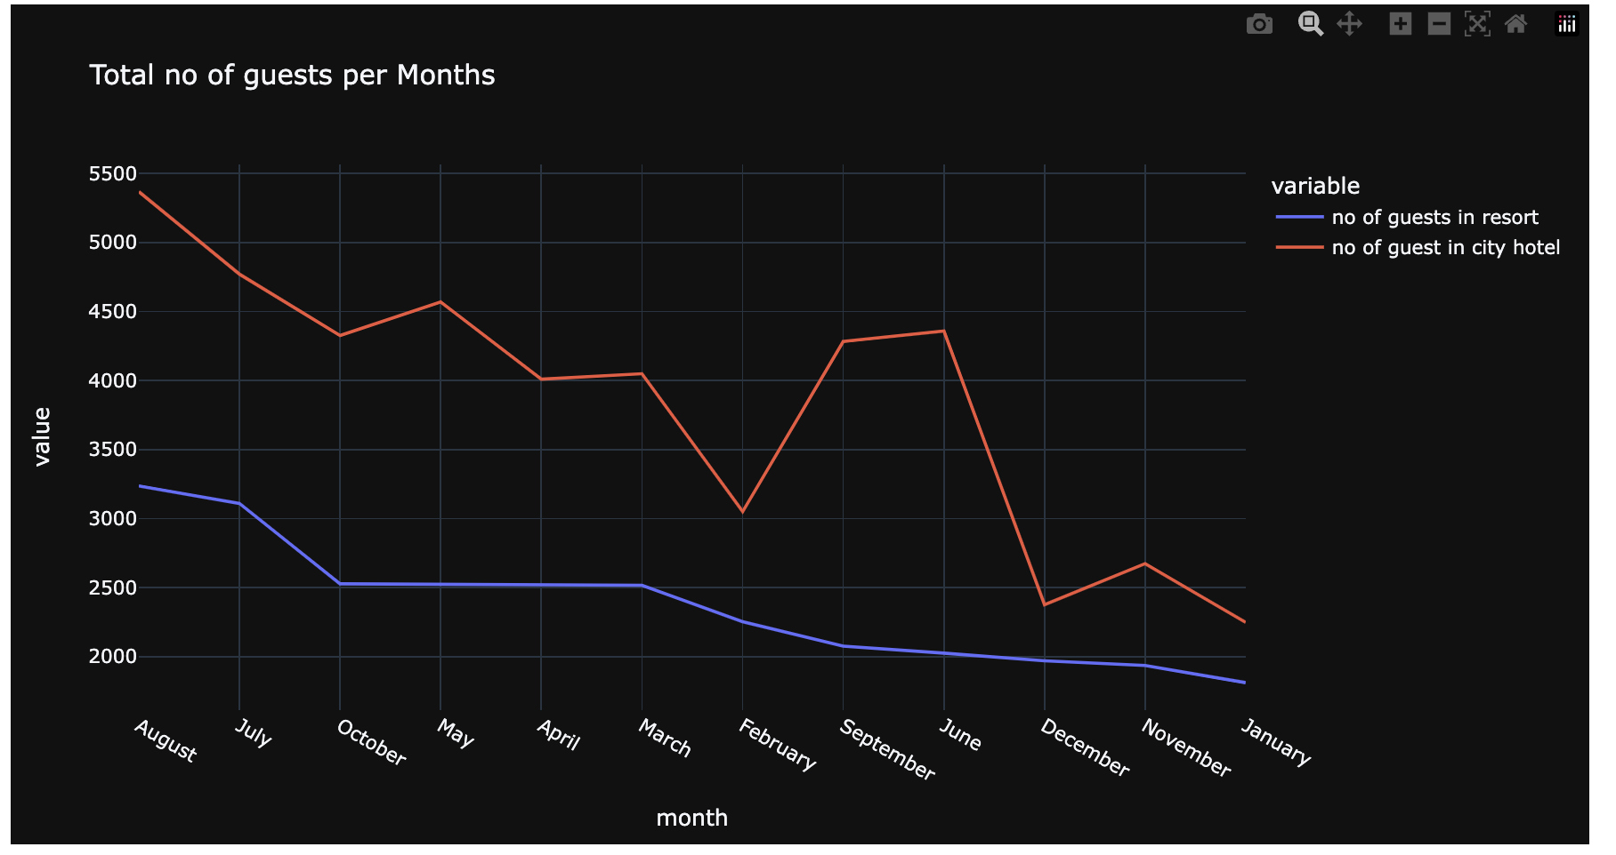
EDA cont.

Slide 12
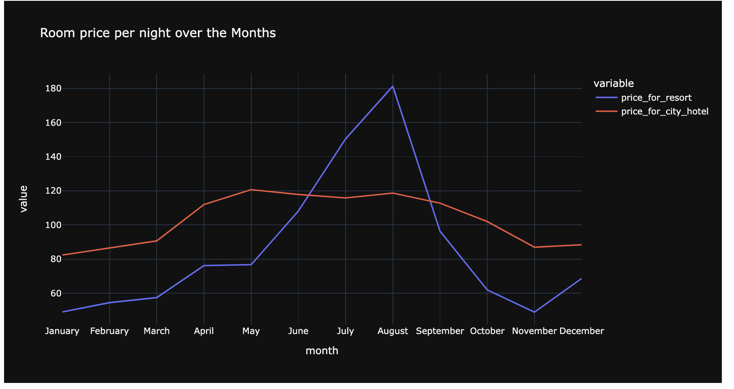
EDA cont.

Slide 13
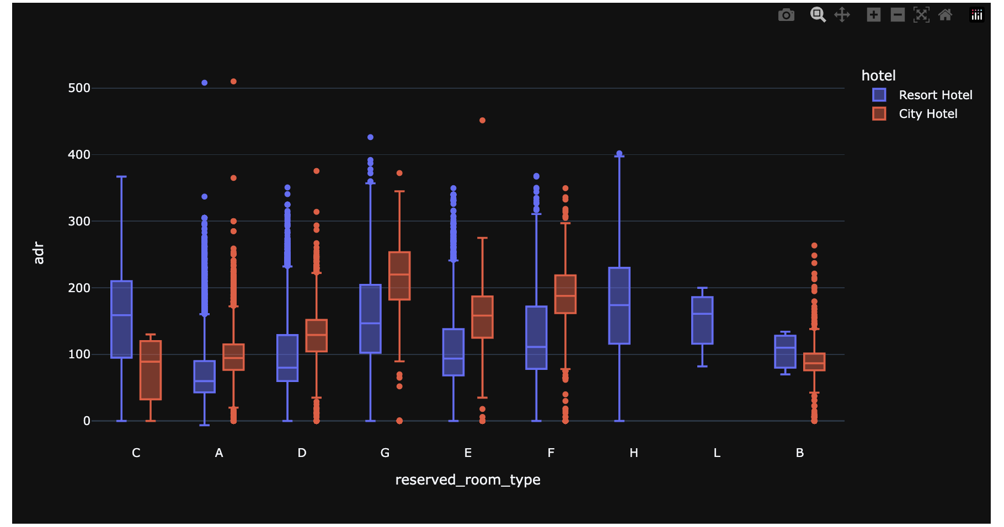
EDA cont.

Slide 14
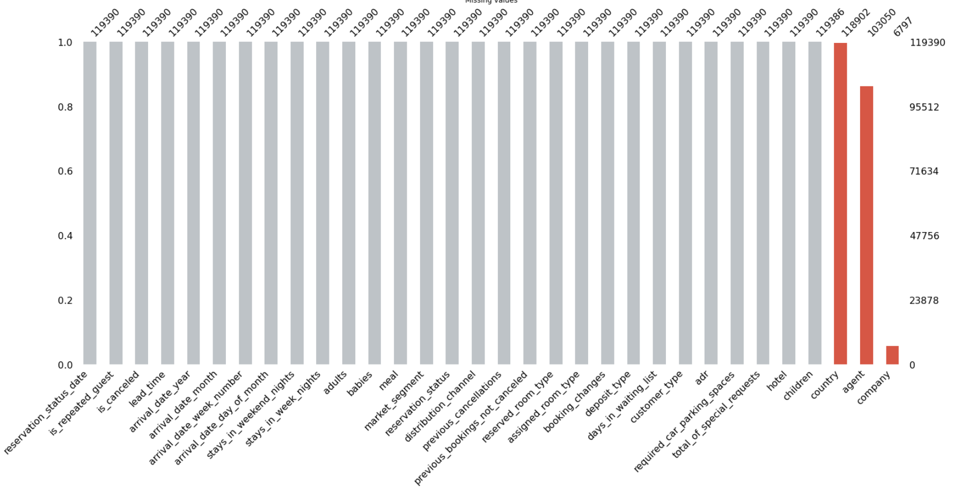
EDA cont.

Slide 15
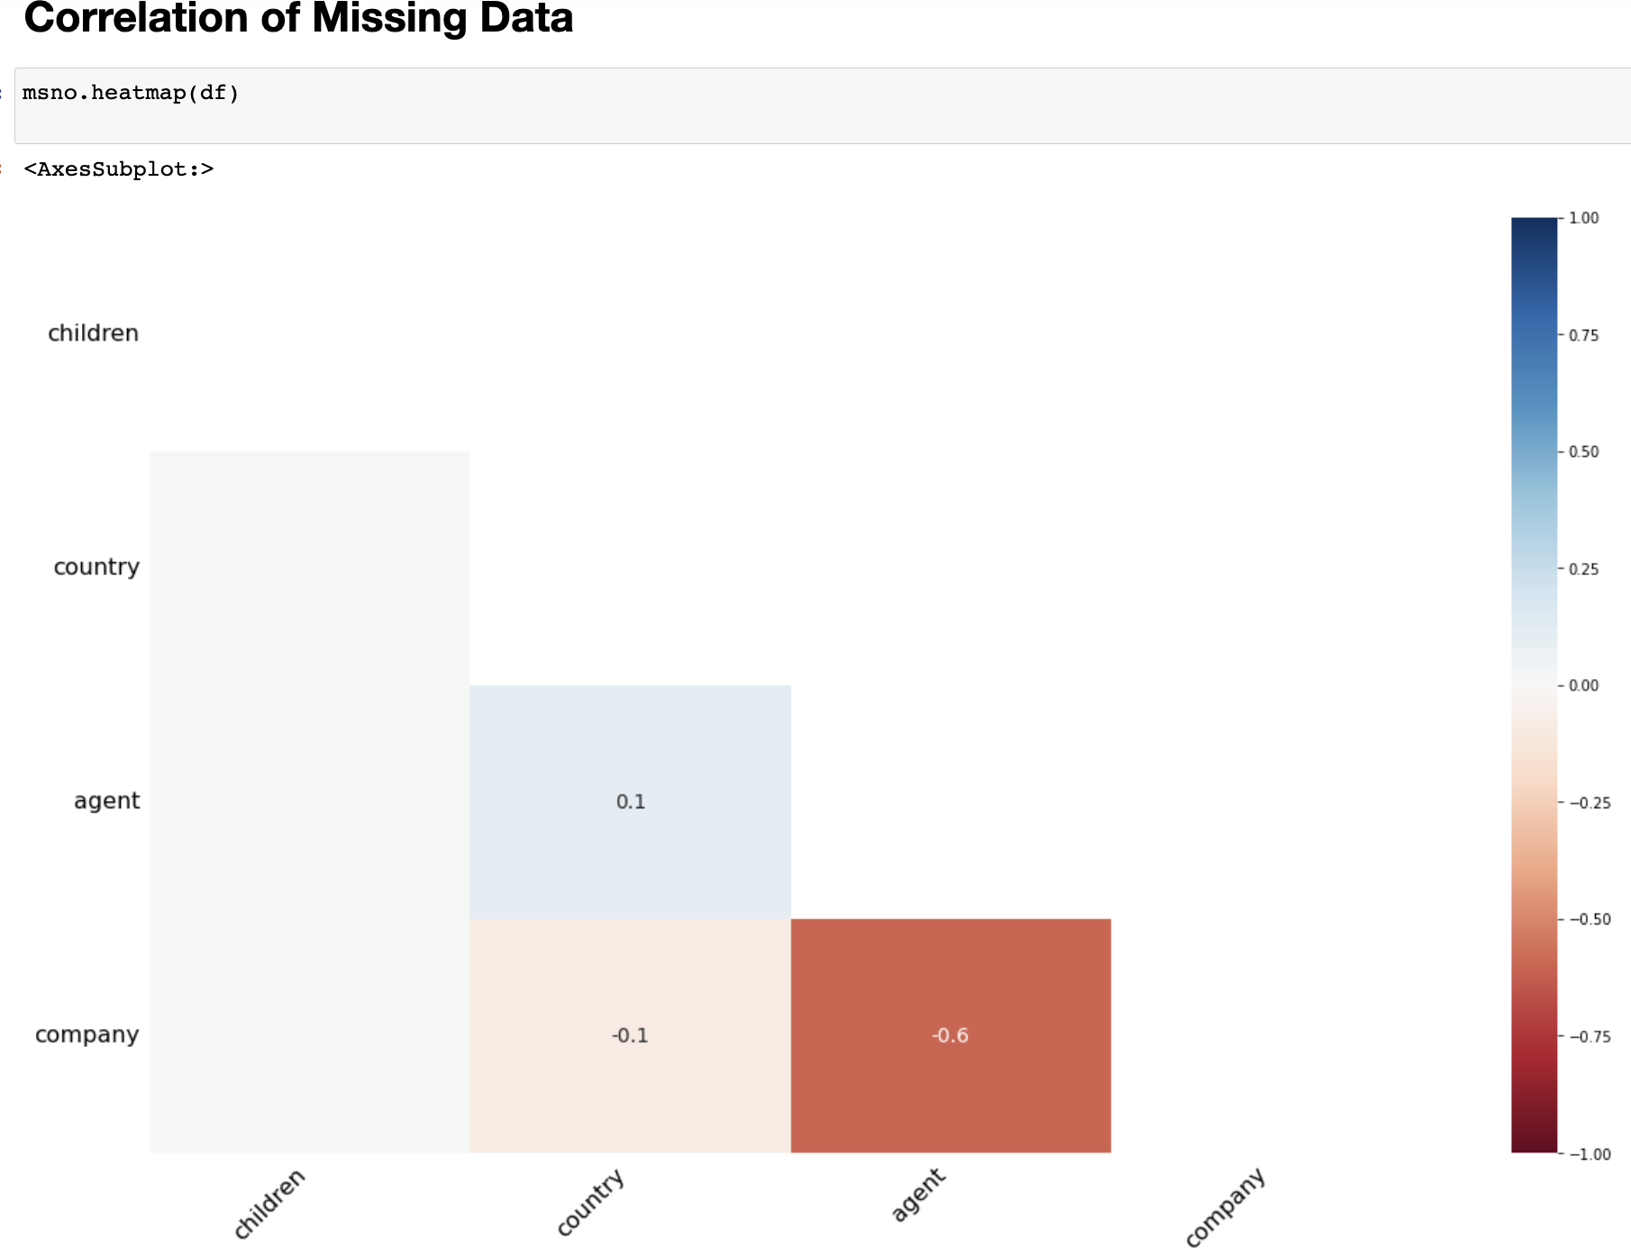
EDA cont.

Slide 16
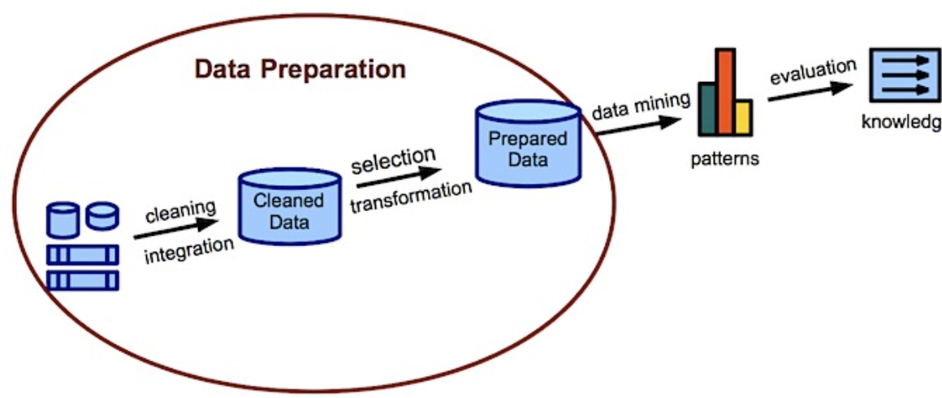
Data Preparation
Dropping columns that are not useful
Differentiating numerical and categorical features
Normalizing numerical variables
Split the value for training and testing

Slide 17
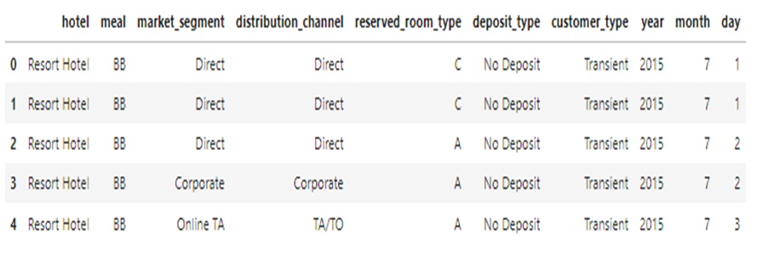
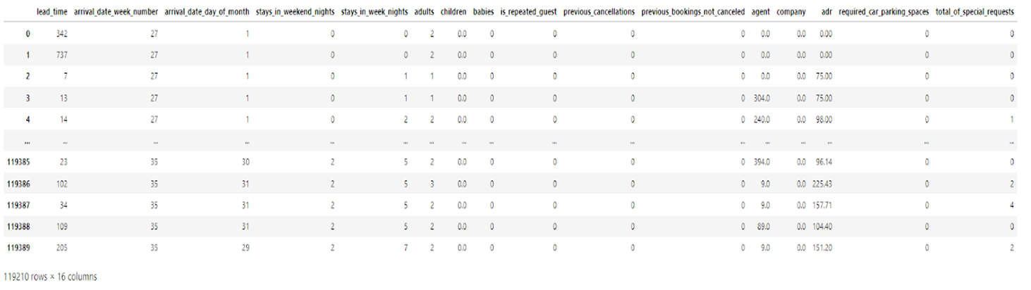
Data Preparation- cont.
Categorical Columns
Numerical columns

Slide 18
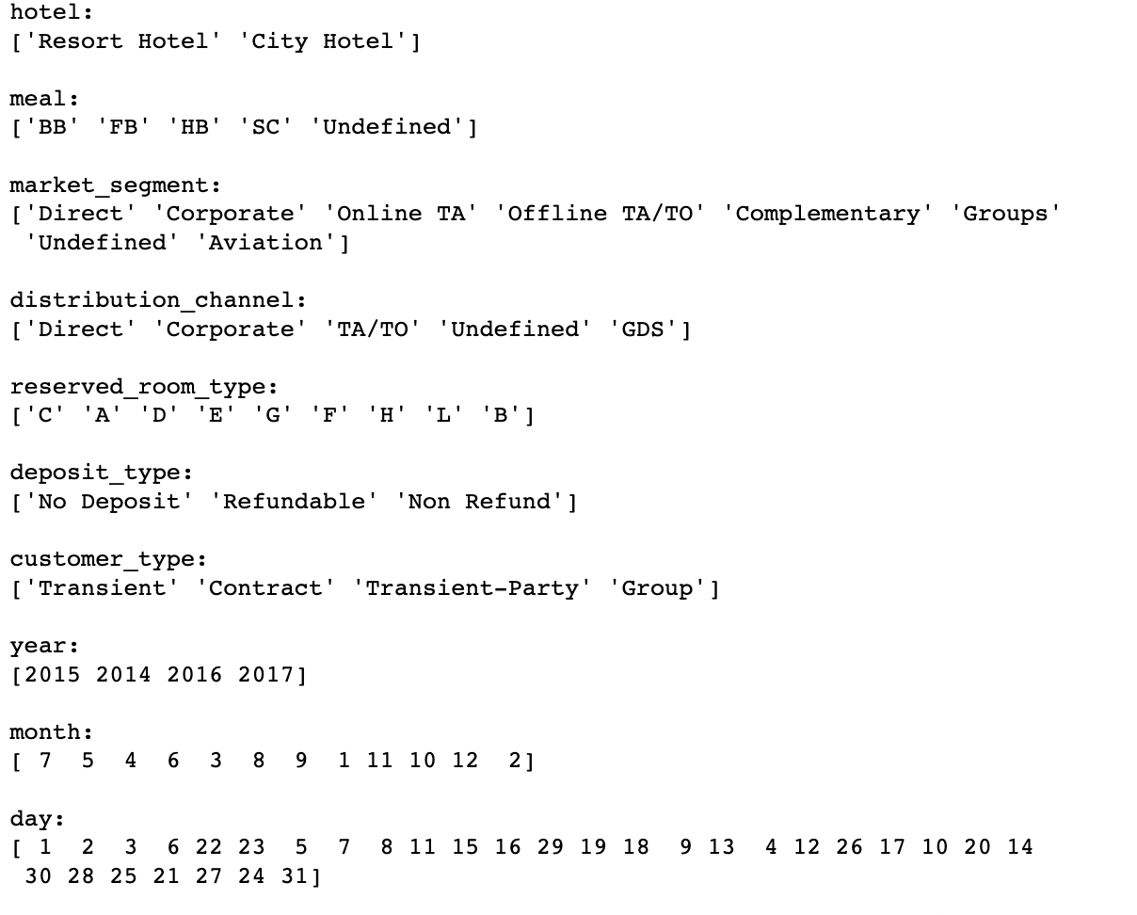
Categorical Variables

Slide 19
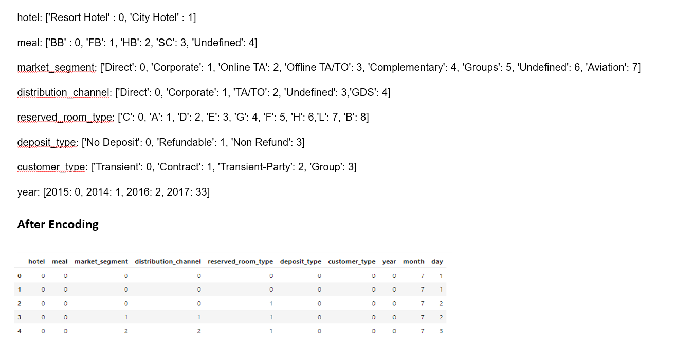
Data Preparation- cont.

Slide 20
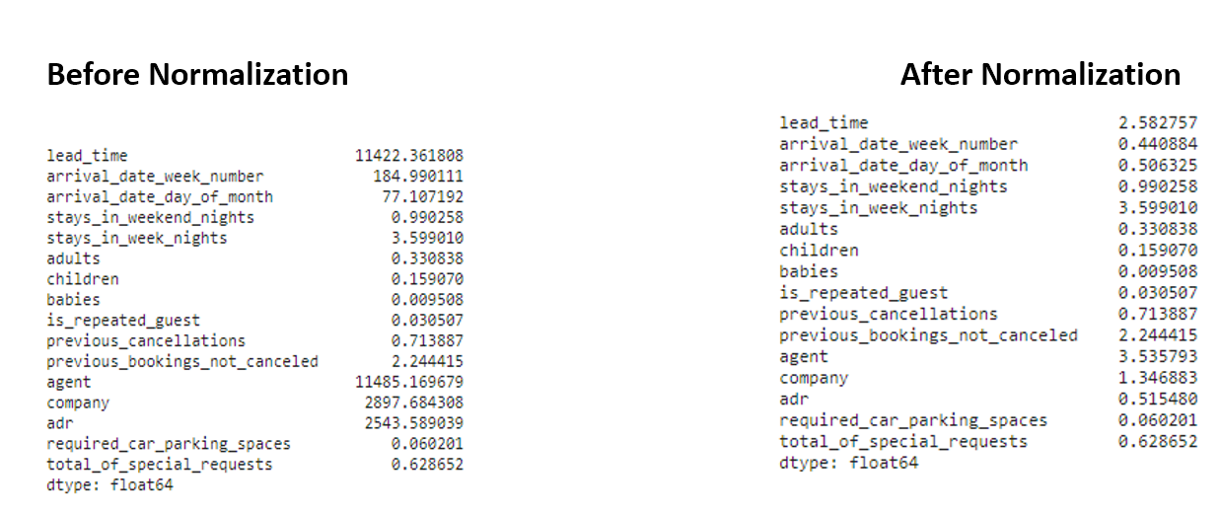
Data Preparation- cont.

Slide 21
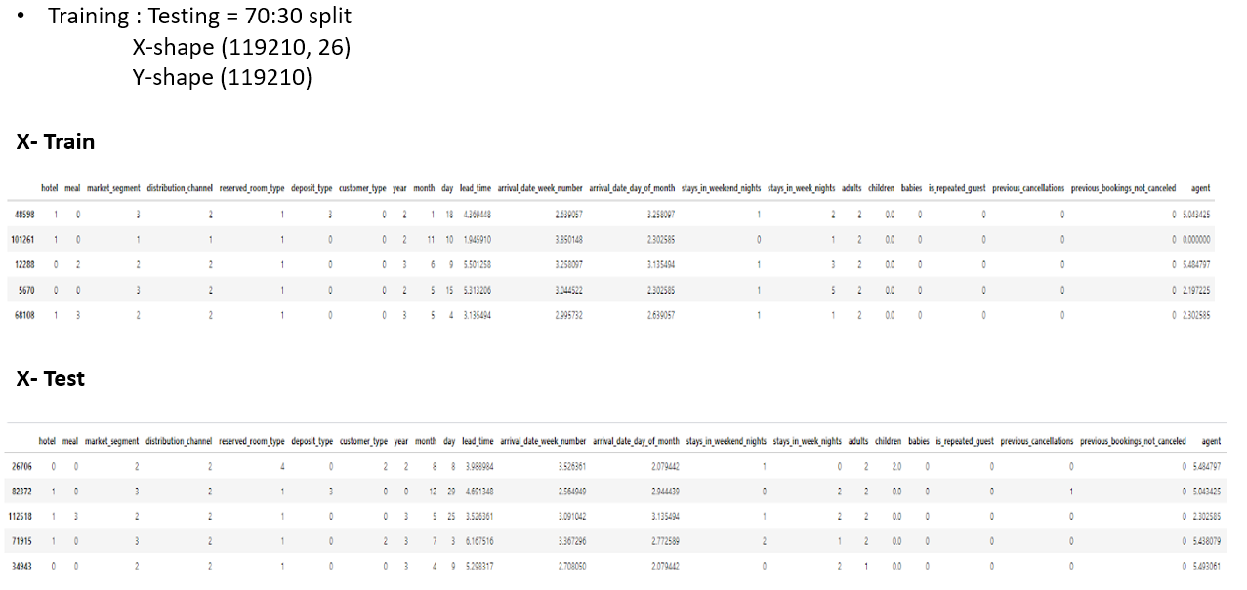
Data Preparation- cont.

Slide 22
Models for Classification
Logistic Regression
KNN
Decision Tree Classifier
Random Forest Classifier
AdaBoost Classifier
Gradient Boosting Classifier
XgBoost
Cat Boost
Extra Trees Classifier
LGBM
Voting Classifier
ANN

Slide 23
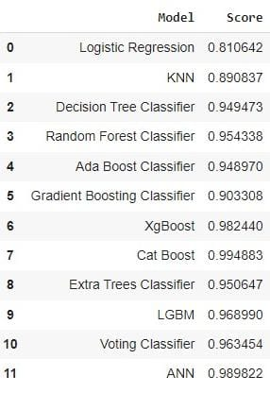
Models Performance

Slide 24
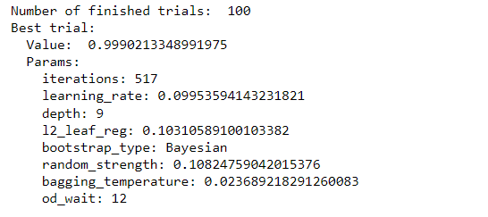
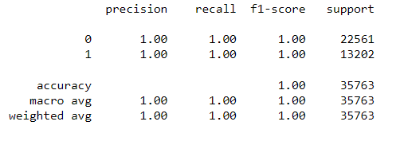
Hyperparameter Tuning
Parameters after tuning
Catboost.
Classification report after
tuning

Slide 25
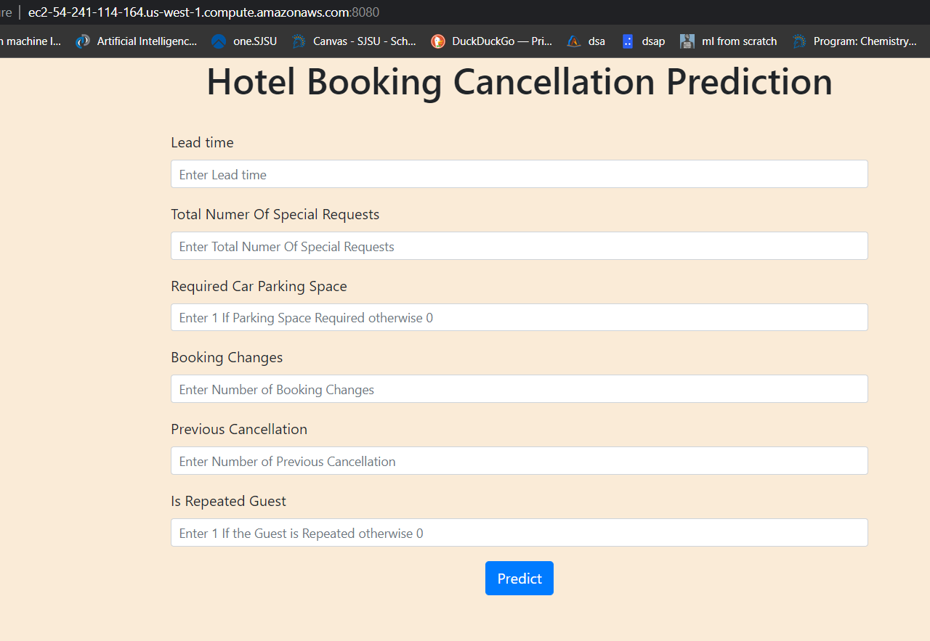
Deployment
Flask
AWS EC2
Predict

Slide 26
Conclusion
Predicting cancellation of hotel room reservations
Performed EDA and Preprocess the data
Analyzed various models and deployed the best performed after hyper parameter tuning

Slide 27
Future scope Enhancement
To gather data from other countries as well to make this application more scalable.
Perform hyper parameter tuning on other models

Slide 28
References
https://bigdataanalyticsnews.com/data-preparation-why-is-it-important/
https://www.datacamp.com/tutorial/understanding-logistic-regression-python
Cho, V. (2003). A comparison of three different approaches to tourist arrival forecasting. Tourism management, 24(3), 323-330.
Sánchez-Medina, A. J., & Eleazar, C. (2020). Using machine learning and big data for efficient forecasting of hotel booking cancellations. International Journal of Hospitality Management, 89, 102546.
Adil, M., Ansari, M. F., Alahmadi, A., Wu, J. Z., & Chakrabortty, R. K. (2021). Solving the problem of class imbalance in the prediction of hotel cancellations: A hybridized machine learning approach. Processes, 9(10), 1713.
Antonio, N., de Almeida, A., & Nunes, L. (2019). Hotel booking demand datasets. Data in brief, 22, 41-49
https://www.gannett-cdn.com/presto/2019/05/02/USAT/5b1d7ecc-ce8d-43db-92b9-d7b61c198063-GettyImages-912299740.jpg?width=660&height=440&fit=crop&format=pjpg&auto=webp
https://qph.cf2.quoracdn.net/main-qimg-a4abb9bf41f92a149ae1df6762635254-pjlq
https://tinyurl.com/yckpxmut
https://tinyurl.com/4u4hv8va

Slide 29
Thank You

